Slide 1
Exercise 1 –
FreeBSD Installation
Announced Date: 2006/9/20
Due Date: 2005/10/4

Slide 2
Outline
FreeBSD version
Installing FreeBSD
Update source and make world
Rebuild kernel

Slide 3
FreeBSD branches
Two parallel development branches:
  -STABLE
    Receive only well-tested bug fixes and other small incremental enhancement
    Latest Release version:
      5.5 May, 2006
      6.1 May, 2006
  -CURRENT
    Latest working sources for FreeBSD
    Latest Release version:
      7.0-CURRENT

Slide 4
FreeBSD version
A.B.C – Type
  A: major version Number
  B: minor version Number
  C: slight patch version number
  Type: version type
    SNAP
    ALPHA、BETA、GAMMA
    RELEASE
    RELENG
    STABLE
    CURRENT
Alpha
Beta
Gamma
Snapshot →
→ Release → Releng → Stable
Notes:
RELENG -> unofficial version that is used to test stable version
SNAP -> unofficial version that is used to test current version
RELEASE -> official version
http://www.study-area.org/freebsd/fbsd-his.htm

Slide 5
FreeBSD view of Disk (1)
What is the meaning of ad0s1e
  Disk name
    IDE: ad
    SCSI: da
  Slice is equal to the partition of common use
    Primary partition: s1 ~ s4
    Extended partition: s5 ~ sn
  Label in each slice
    a: root partition
    b: swap
    c: entire disk
    d: entire partition
    efgh: /usr, /home, …
MBR
Slice 1 (/dev/ad0s1)
Slice 2 (/dev/ad0s2)
Slice 3 (/dev/ad0s3)
Slice 4 (/dev/ad0s4)
Slice 5 (/dev/ad0s5) | Slice 6 (/dev/ad0s6)
Notes:
http://www.freebsd.org/doc/en_US.ISO8859-1/books/handbook/install-steps.html

Slide 6
FreeBSD view of Disk (2)
An Example
MBR
Slice 1 (ad0s1)
Slice 2 (ad0s2)
Slice 3 (ad0s3)
Slice 4 (ad0s4)
Windows XP (NTFS)
Linux (EXT3FS)
disklabel
ad0s3a
ad0s3b
ad0s3c
ad0s3d
ad0s3e
/ (root)
swap
Extended Partiton
/home
D-Disk NTFS | Linux Swap

Slide 7
Installing FreeBSD
Steps
  Knowing your hardware
  Obtaining installation file
  Booting from CD
  sysinstall main menu
  Custom Installation Options
    Partition
    Label
    Distribution
    Media
    Commit
  Post Installation

Slide 8
Installing FreeBSD –
1. knowing your hardware
CPU
  32bit or 64bit
  Intel、AMD or other brand
  Pentium-II, Pentium4, Xeon, XP1700+, Optron, C3
RAM
  Size
HD
  Size, amount, SCSI or IDE
VGA
  Brand, ram size
Sound
  Brand
Network Interface Card
  Brand
  IP、Netmask、default gateway、Hostname、DNS
Other Special device

Slide 9
Installing FreeBSD –
2. Obtaining installation file
FreeBSD installation CD
  ftp://freebsd.csie.nctu.edu.tw/pub/ISO-IMAGES-i386/6.1/6.1-RELEASE-i386-bootonly.iso
  ftp://freebsd.csie.nctu.edu.tw/pub/ISO-IMAGES-i386/6.1/6.1-RELEASE-i386-disc1.iso
  Burn!
Boot Floppy Image
  ftp://freebsd.csie.nctu.edu.tw/pub/releases/i386/6.1-RELEASE/floppies/boot.flp
  ftp://freebsd.csie.nctu.edu.tw/pub/tools/fdimage.exe
  C:\fdimage.exe boot.flp a:\

Slide 10
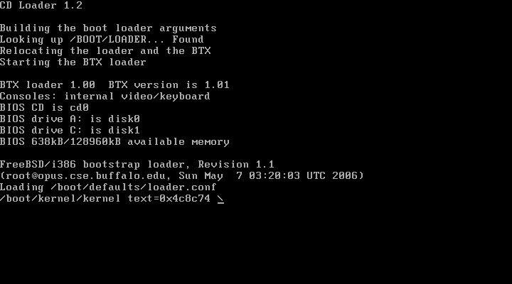
Installing FreeBSD –
3. Booting from CD

Slide 11
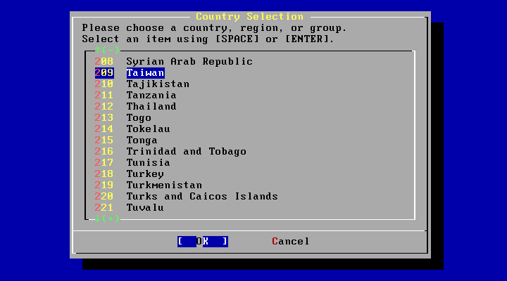
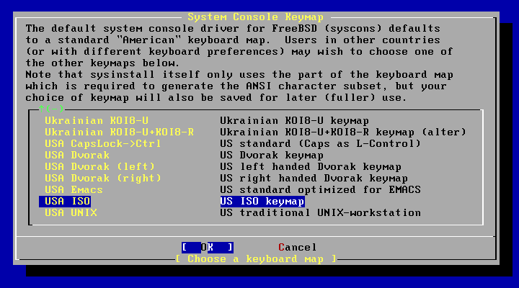
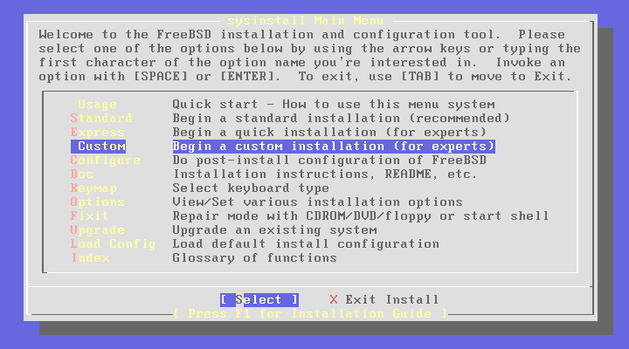
Installing FreeBSD –
4. sysinstall Main Menu
You can press “Scroll Lock” key to see probe results.
sysinstall Main Menu
  Contry Selection “Taiwan”
  Console Keymap “USA ISO”
  Choose “Custom”

Slide 12
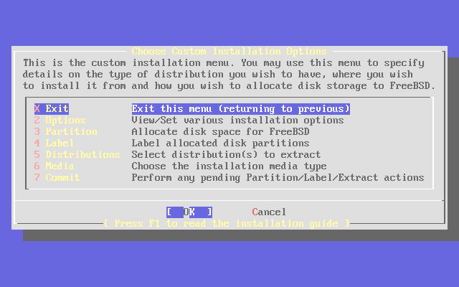
Installing FreeBSD –
5. Custom Installation Options
5 major steps
  Partition your disk
  Label your disk
  Choose what to install
  Choose how to install
  Commit

Slide 13
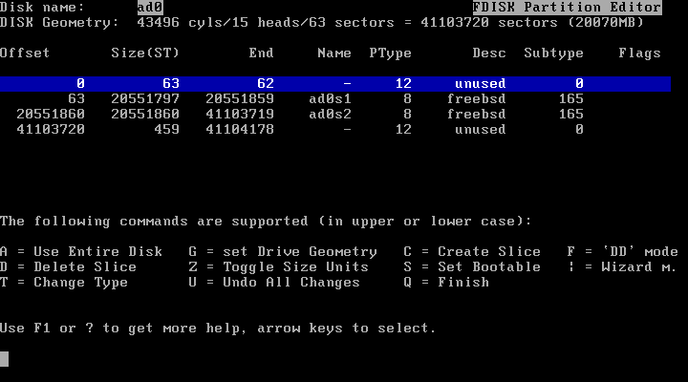
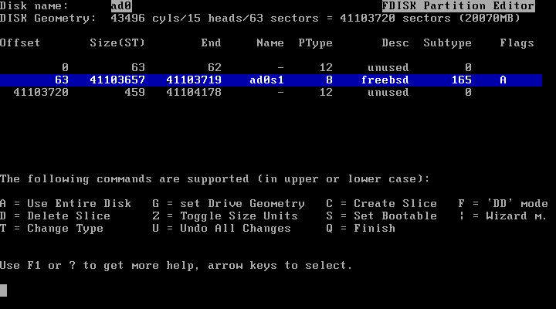
Installing FreeBSD –
5. Custom Installation – partition (1)
Create slice and choose boot manager
  Press “C” to create a new slice or press “A” to use entire disk
  Press “S” to toggle ad0s1 as bootable (we will put / on this slice)
  Press “Q” to next step (Select Boot Manager)

Slide 14
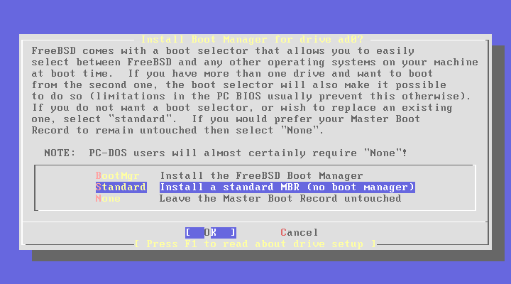
Installing FreeBSD –
5. Custom Installation – partition (2)
  Select “Standard” for ad0
    BootMgr ➔ Multiple OS
    Standard ➔ Single OS
    None ➔ Other BM
  After press OK, it will back to Custom Installation Options menu

Slide 15
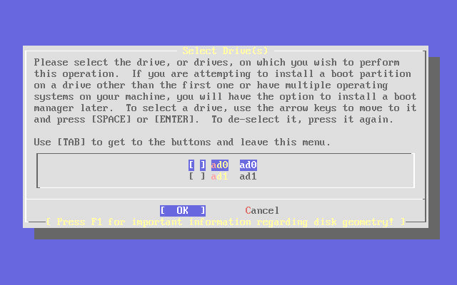
Installing FreeBSD –
5. Custom Installation – partition (3)
If you have more than one disk…
  You can choose whether to partition it.
  Install “BootMgr” for first disk and “none” for rest ones

Slide 16
Installing FreeBSD –
5. Custom Installation – Label (1)
Disklabel Editor
  Move blue bar to select slice
  Press “C” to create disk label
    swap , / ( and /home, /var, …)
      Specify size
      Choose type (either swap or FS)
      Specify mount point
  Press “S” to toggle SoftUpdates (async written to disk)
  Press “Q” to next step (back to custom installation options menu)

Slide 17
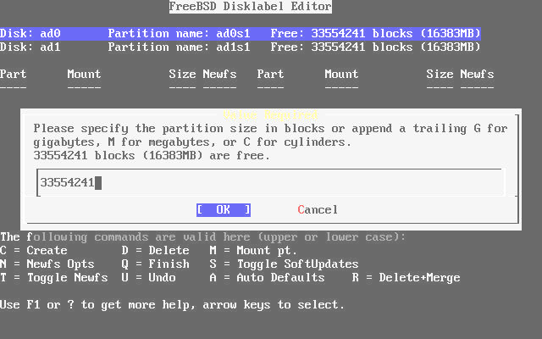
Installing FreeBSD –
6. Custom Installation – Label (2)
  Create label in ad0 and specify size

Slide 18
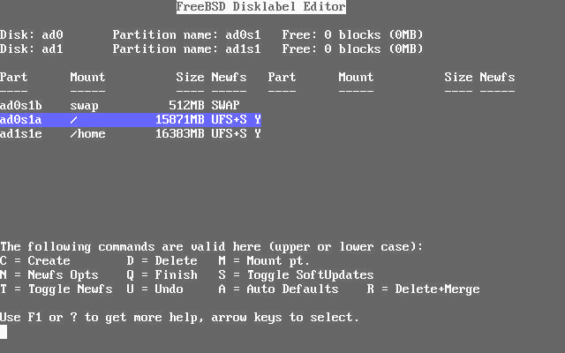
Installing FreeBSD –
6. Custom Installation – Label (3)
  Complete disklabel

Slide 19
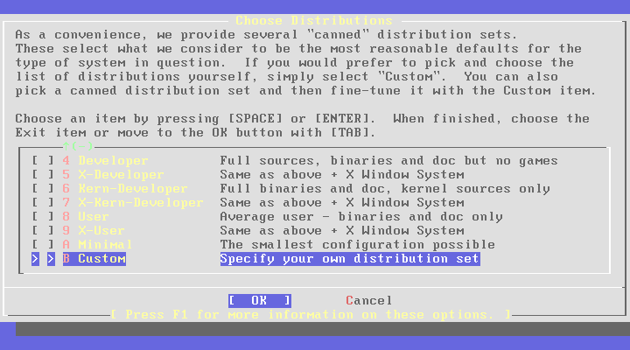
Installing FreeBSD –
6. Custom Installation – distri. (1)
Choose Distributions Menu
  Choose “Custom”

Slide 20
Installing FreeBSD –
6. Custom Installation – distri. (2)
Select
  base ; binary
  kernels(all) ; Generic kernel and SMP kernel
  Man ; Manual
  src ; FreeBSD Source Code
  ports ; FreeBSD Software Collection
  local ; local additions
After Selection
  Press “OK” and it will return to “Choose Distributions menu”
  Press “OK” again to back to “Custom Installation Options menu”
  Select “Media”

Slide 21
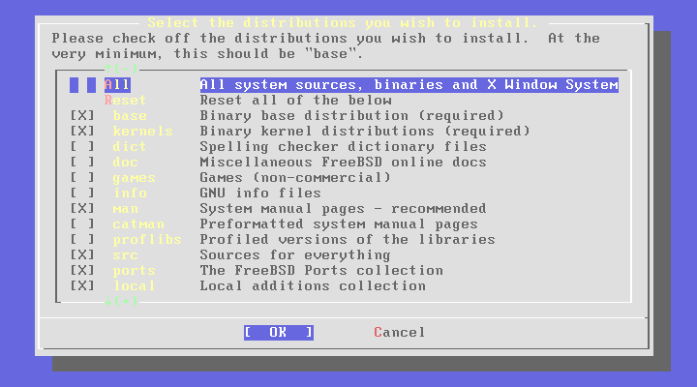
Installing FreeBSD –
6. Custom Installation – distri. (3)

Slide 22
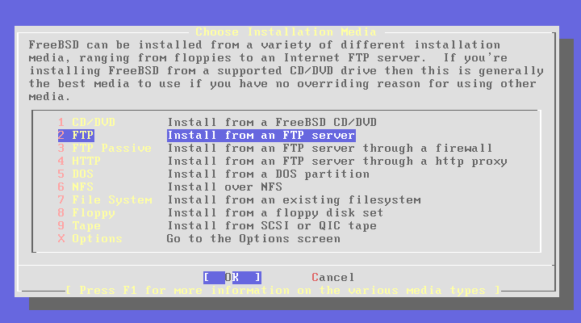
Installing FreeBSD –
6. Custom Installation – Media (1)
  Choose CD/DVD if you have 6.1 Stable CD
  Choose FTP if your NIC is detected
    Choose FTP Passive if you in private network

Slide 23
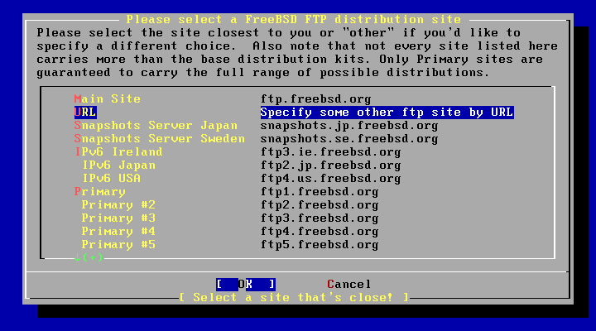
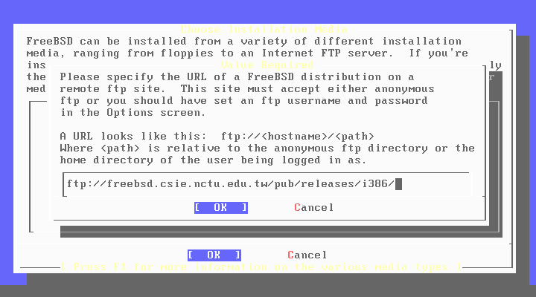
Installing FreeBSD –
6. Custom Installation – Media (2)
Install through FTP
  Specify ftp server and path

Slide 24
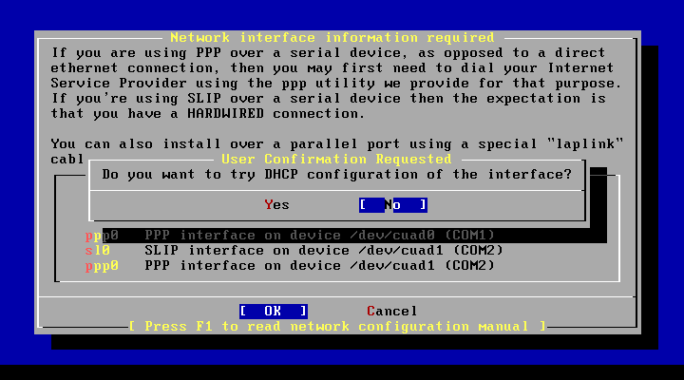

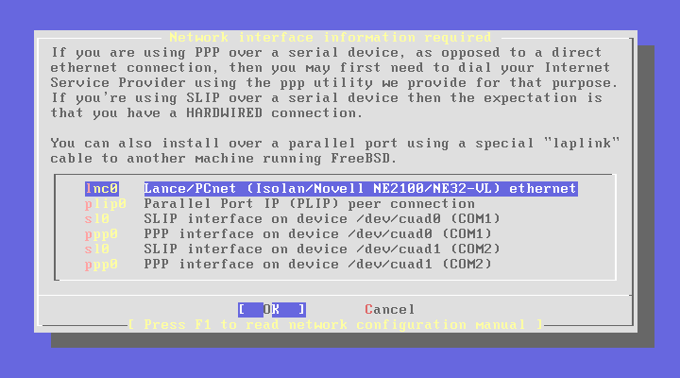
Installing FreeBSD –
6. Custom Installation – Media (3)
  Select NIC
  IPv6 and DHCP

Slide 25
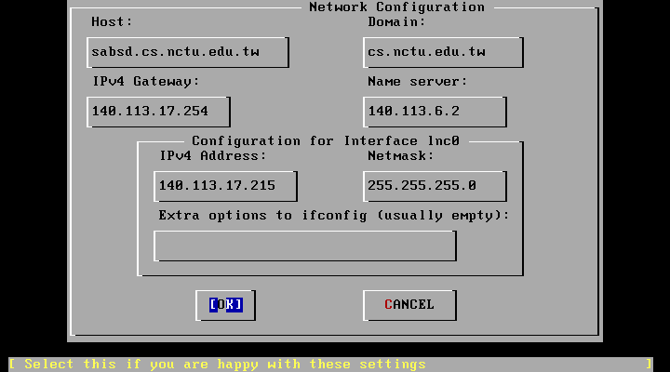
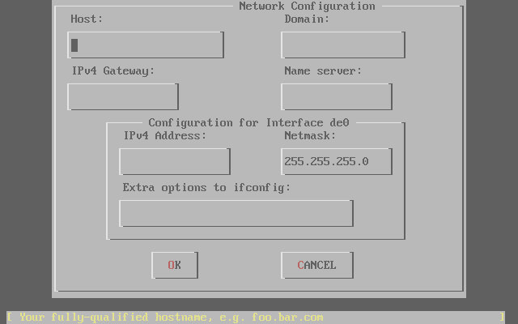
Installing FreeBSD –
6. Custom Installation – Media (4)
  Specify your IP information
  Press “OK” to next step

Slide 26
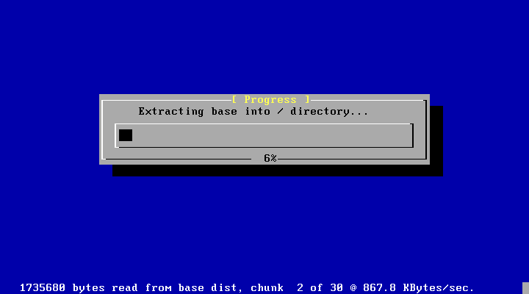
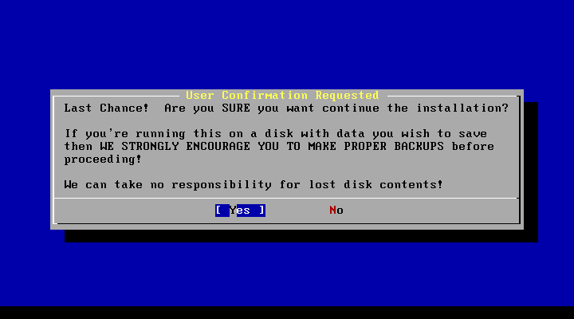
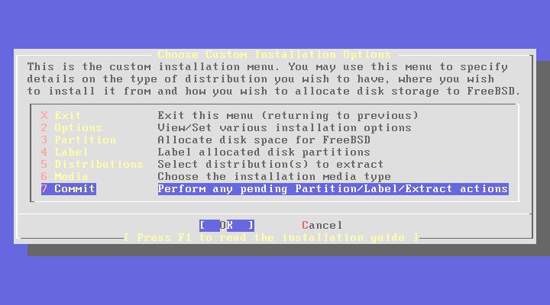
Installing FreeBSD –
6. Custom Installation – Commit
Start to format disk、make file system and install software
You can press “Alt + F2” to see the install detail

Slide 27
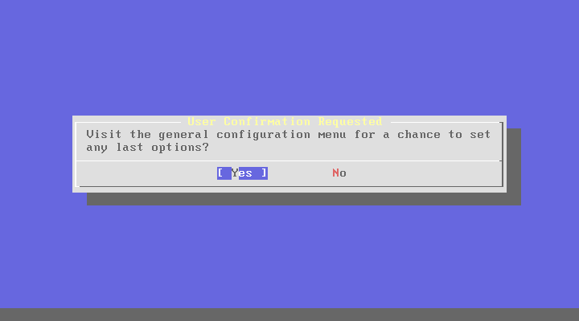
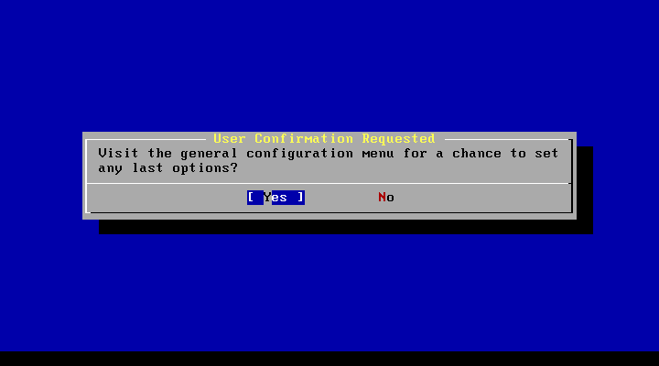
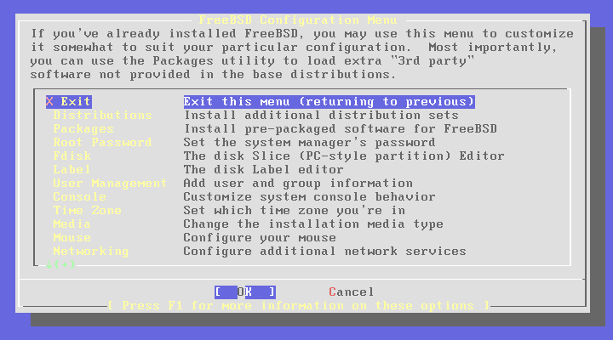
Installing FreeBSD –
7. Post Installation (1)

Slide 28
Installing FreeBSD –
7. Post Installation (2)
Root Password
Time Zone → Asia → Taiwan
Mouse → enable
Networking → sshd
Packages (optional)
  net/csup
  editors/vim-lite

Slide 29
Exercise 1 –
FreeBSD build world and kernel

Slide 30
FreeBSD source
Maintained in a CVS repository in California
  Two softwares to get the latest FreeBSD source
    CVSup
    CSup – A rewrite of the CVSup file updating client in C
We can use CSup keep our FreeBSD source up-to-date with any FreeBSD mirror sites
  Install CSup
  Edit CSup supfile
  Update source using CSup
Up-to-date your system
  Build world & kernel using the updated source.
  Install softwares.
  Upgrade softwares.

Slide 31
FreeBSD source
CSup Installation
Install via pkg_add
  Package is pre-compiled application
  % pkg_add ftp://freebsd.csie.nctu.edu.tw/pub/releases/i386/6.1-RELEASE/packages/net/csup-20060223_1.tbz
  pkg_add package-name
  pkg_delete package-name
  pkg_info package-name
  All installed package is stored in /var/db/pkg
The csup binary is in /usr/local/bin/csup
  You can use “whereis” command to find something

Slide 32
FreeBSD source
CSup Configuration file (1)
Example csup supfile
  /usr/share/examples/cvsup/stable-supfile
  /usr/share/examples/cvsup/ports-supfile
Create your own supfile
  Edit /usr/local/etc/cvsup-src
  Edit /usr/local/etc/cvsup-ports

Slide 33
FreeBSD source
CSup Configuration file (2)
/usr/local/etc/cvsup-src
*default host=freebsd.csie.nctu.edu.tw Where to get source
*default base=/usr Where to put status file
*default prefix=/usr Where to put source
*default delete use-rel-suffix Allow cvs to delete
*default compress Compress before transmit
*default release=cvs tag=RELENG_6
src-all
Notes:
http://www.freebsd.org/doc/en_US.ISO8859-1/books/handbook/cvsup.html
man cvsup

Slide 34
FreeBSD source
CSup Configuration file (3)
CVS tags
  Branch Tags
    . (FreeBSD-CURRENT line)
    RELENG_6 (FreeBSD 6-STABLE line)
    RELENG_5 (FreeBSD 5-STABLE line)
  Release Tags
    RELENG_6_1 (FreeBSD 6.1-RELEASE)
    RELENG_5_5 (FreeBSD 5.5-RELEASE)
  To refer to a specific point in time
    RELENG_6_1_0_RELEASE
    RELENG_5_5_0_RELEASE
http://www.freebsd.org/doc/en_US.ISO8859-1/books/handbook/cvs-tags.html
Notes:
http://www.freebsd.org/doc/en_US.ISO8859-1/books/handbook/cvs-tags.html

Slide 35
FreeBSD source
CSup Configuration file (4)
/usr/local/etc/cvsup-ports
*default host=freebsd.csie.nctu.edu.tw
*default base=/usr
*default prefix=/usr
*default delete use-rel-suffix
*default compress
*default release=cvs tag=.
ports-all

Slide 36
FreeBSD source
CSup Configuration file (5)
you can put them all together in /usr/local/etc/cvsup-all
*default host=freebsd.csie.nctu.edu.tw
*default base=/usr
*default prefix=/usr
*default delete use-rel-suffix
*default compress
*default release=cvs tag=RELENG_6
src-all
ports-all tag=.

Slide 37

FreeBSD source
Update source using CSup
Update both src and ports
  % /usr/local/bin/csup -L 1 /usr/local/etc/cvsup-all > /var/log/csup.log
The “–L 1” tells cvsup to print out the details of
all the file updates it is doing.
from 0 (silent) to 2

Slide 38
Rebuilding world & kernel
The canonical way to update system
  make buildworld
  make buildkernel
  make installkernel
  reboot and boot in single user mode
  mergemaster -p
  make installworld
  mergemaster
  reboot

Slide 39
Rebuilding world & kernel –
Prepare make.conf
Example make.conf
  /usr/share/examples/etc/make.conf 5.x ~ 6.x
  Everything add in make.conf is used every time you run make
  KERNCONF=CHBSD
  CPUTYPE?=pentium4
man make.conf has detail descriptions of it
Available CPUTYPE:
See /usr/share/mk/bsd.cpu.mk

Slide 40
Rebuilding world & kernel – make buildworld
Build FreeBSD entire system
  % cd /usr/src
  % make buildworld >& /var/log/world.log &
make –j n buildworld
Spawn multiple (n) processes to do make.
The compiling processes of make world is I/O bound.

Slide 41
Rebuilding world & kernel – make buildkernel (1)
Why rebuild kernel?
  Faster boot time.
    Probe only necessary device
  Lower memory usage
    Smaller kernel image
  Additional hardware support.

Slide 42
Rebuilding world & kernel – make buildkernel (2)
Edit kernel config file
  cd /usr/src/sys/i386/conf
    GENERIC may not have all for your system
    LINT has every options
      %use “make LINT” to generte the LINT file
  cp GENERIC “YOUR-NAME”
    We often use hostname to be “YOUR-NAME”
  edit config file
    Depend on your system
    Be attention to related options
    Following the explanation of http://www.freebsd.org/doc/en_US.ISO8859-1/books/handbook/kernelconfig-config.html

Slide 43
Rebuilding world & kernel – make buildkernel (3)
Build kernel
  % cd /usr/src
  % make KERNCONF=CHBSD buildkernel
If the KERNCONF=“YOUR-NAME”
has been set in your make.conf
You can use “make buildkernel” instead

Slide 44
Rebuilding world & kernel – make installkernel
Install kernel
  % cd /usr/src
  % make KERNCONF=CHBSD installkernel
make buildkernel && make installkernel
＝ make buildkernel installkernel
＝ make kernel

Slide 45
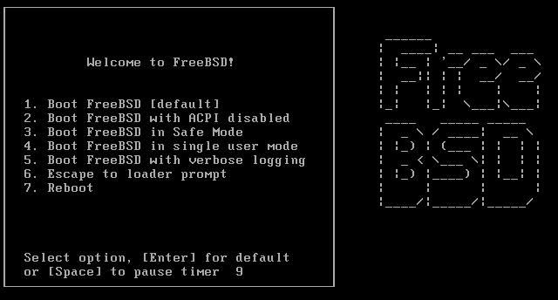
Rebuilding world & kernel – reboot into single user mode
Boot in single user mode
  Press “4”
  Or
  % shutdown now
    For a running system, this will drop it to single user mode

Slide 46
Rebuilding world – make installworld
mergemaster -p
  -p
  Pre-buildworld mode. Compares only files known to be essential to the success of {build|install}world, including /etc/make.conf.
Install the built world
  % make installworld

Slide 47
Rebuilding world – mergemaster
mergemaster
  Synchronize /usr/src/etc with /etc
  Choose “i” for most case, such as
    /etc/defaults/rc.conf, …
  Press “enter” for certain file, such as
    master.passwd, hosts, csh.*

Slide 48
Reboot
Reboot and enjoy it
  % reboot

Slide 49
If Something Goes Wrong … (1)
Possible errors in building new kernel
  Configuration file
    % cd /usr/src/sys/i386/conf/
    % config CHBSD
  make fail
  Install fail
  Kernel does not boot
    Boot with old kernel, recompile kernel
  Kernel works, but ps does not work
    Build world

Slide 50
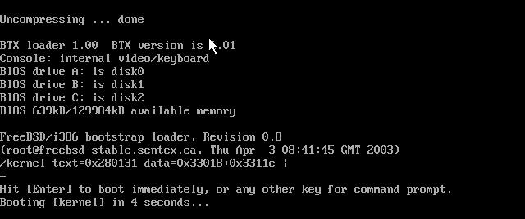
If Something Goes Wrong … (2)
Boot with old kernel
  In 5.x ~
    Press “6”
    Type “boot /boot/kernel.old/kernel”
  In 4.x
    Hit any key other than “enter” when counting down
    Type “unload”
    Type “load /kernel.old”
    Type “boot”

Slide 51
If Something Goes Wrong … (3)
Move working kernel to /boot/kernel
  % mv /boot/kernel.old /boot/kernel
For versions of FreeBSD prior to 5.x
  Unlock kernel
    % chflags noschg /kernel
    % cp kernel.old kernel
    % sync;sync; reboot
  Lock kernel
    % chflags schg /kernel
Use ls –lo to check similar file
schg → set the immutable (永遠不變的) flag
ls –o → include file flags in long output

Slide 52
Install software
Package
  Pre-built ports
  pkg_add, pkg_delete, pkg_deinstall, pkg_info, pkg_version
Ports
  cd /usr/ports, make search, make install clean
  ports/sysutils/portupgrade
    portinstall, portupgrade, portversion
    /usr/local/etc/pkgtools.conf
Source
  Tar ball
  tar xzvf certain-source.tar.gz
  ./configure
  make; make install

Slide 53
How to use ports
Using ports
  Steps of install software
    (1) Figure out the path to the software
      % cd /usr/ports
      % make search key=mutt
      % cd /usr/ports/chinese/mutt
    (2) Fetch and compile the source
      % make install
  Uninstall
    % make deinstall
  ※Using portupgrade
    portinstall ＝ portupgrade –N
    pkgtools.conf

Slide 54
How to use ports (1)
Try to install some software, such as:
  vim
  mutt
  wget

